Slide 1
Introduction to Data Structures and Functions
Dr. Alexander Victor
Alexander.victor@dbs.ie

Slide 2


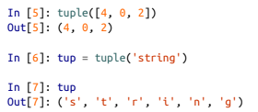


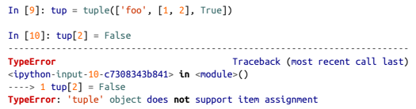
Tuple
Fixed length, immutable Python object
For nested tuples or more complicated expressions,parentheses should be used
You can convert to tuple and access each component with the corresponding number
Once created, the object in the location cannot be modified
Objects in a tuple, if mutable, can be modified in place and other operators can be used

Slide 3
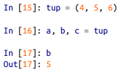
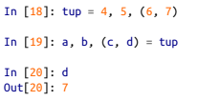
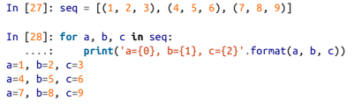
Unpacking Tuples
If you try to assign to a tuple-like expression of variables, Python will attempt to unpack the value on the righthand side of the equals sign:
Sequences of nested tuples can be unpacked also, useful for iterating over sequences of tuples

Slide 4
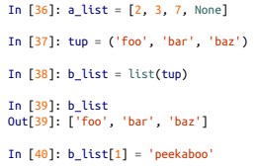

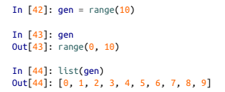
Lists
In contrast with tuples, lists are variable-length and their contents can be modified in-place. You can define them using square brackets [] or using the list type function
Lists and tuples are semantically similar (though tuples cannot be modified) and can be used interchangeably in many functions.
The list function is frequently used in data processing as a way to materialize an iterator or generator expression:

Slide 5
Lists
In contrast with tuples, lists are variable-length and their contents can be modified in-place. You can define them using square brackets [] or using the list type function
Lists and tuples are semantically similar (though tuples cannot be modified) and can be used interchangeably in many functions.
The list function is frequently used in data processing as a way to materialize an iterator or generator expression:

Slide 6


Adding Elements
Elements can be appended to the end of the list with the append method
Using insert you can insert an element at a specific location in the list
The insertion index must be between 0 and the length of the list, inclusive

Slide 7
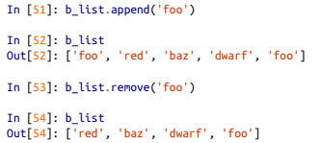

Removing Elements
The inverse operation to insert is pop, which removes and returns an element at a particular index
Elements can be removed by value with remove, which locates the first such value and removes it from the last

Slide 8

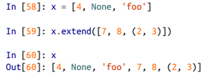

Concatenating and combining lists
Similar to tuples, adding two lists together with + concatenates them
If you have a list already defined, you can append multiple elements to it using the extend method
Using extend to append elements to an existing list, especially if you are building up a large list, is usually preferable.

Slide 9
Concatenating and combining lists
Similar to tuples, adding two lists together with + concatenates them
If you have a list already defined, you can append multiple elements to it using the extend method
Using extend to append elements to an existing list, especially if you are building up a large list, is usually preferable.

Slide 10
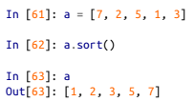
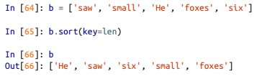
Sorting
You can sort a list in-place (without creating a new object) by calling its sort function
We can sort a collection of strings by their lengths
Soon, we’ll look at the sorted function, which can produce a sorted copy of a general sequence.

Slide 11
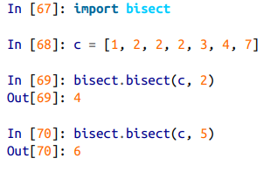


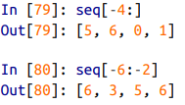
Search and sort
bisect.bisect finds the location where an element should be inserted to keep it sorted, while bisect.insort actually inserts the element into that location
Bisect does not check if the list is sorted so should be used on sorted lists only
You can select sections of most sequence types by using slice notation

Slide 12
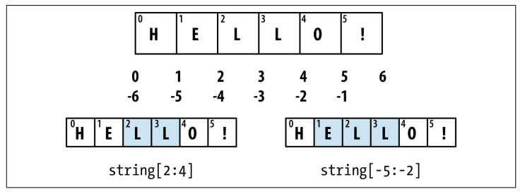

Slide 13
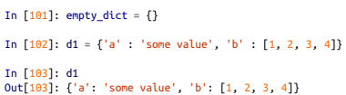
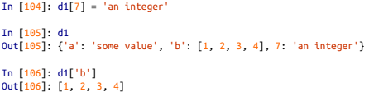

Dict
hash map/associative array.
Flexibly sized collection of key-value pairs, where key and value are Python objects
Create using curly braces {} and colons to separate keys and values
You can access, insert, or set elements using the same syntax as for accessing elements of a list or tuple
You can check if a dict contains a key using the same syntax used for checking whether a list or tuple contains a value:

Slide 14


Dict
You can delete values either using the del keyword or the pop method (which simultaneously returns the value and deletes the key)
The keys and values method give you iterators of the dict’s keys and values, respectively
You can merge one dict into another using the update method

Slide 15
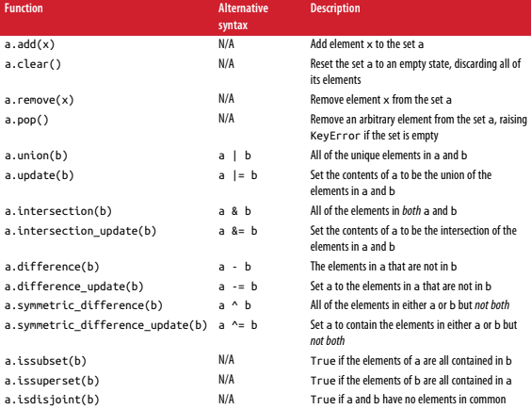

Set
Unordered collection of unique elements
Sets support mathematical set operations like union, intersection, difference, and symmetric difference.

Slide 16




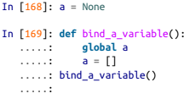
Functions
Functions are declared with the def keyword and returned from with the return keyword
Functions can access variables in two different scopes: global and local
Any variables that are assigned within a function by default are assigned to the local namespace.After the function is finished, the local namespace is destroyed
Assigning variables outside of the function’s scope is possible, but those variables must be declared as global via the global keyword

Slide 17
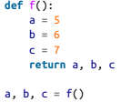

Returning Multiple Values
that the function is actually just returning one object, namely a tuple, which is then being unpacked into the result variables
Alternatively , you could return a dict

Slide 18
Functions are Objects
Since Python functions are objects, many constructs can be easily expressed that are difficult to do in other languages
Suppose we were doing some data cleaning and needed to apply a bunch of transformations to the following list of strings
Lots of things need to happen to make this list of strings uniform and ready for analysis: stripping whitespace, removing punctuation symbols, and standardizing on proper capitalization
One way to do this is to use built-in string methods along with the re standard library module for regular expressions

Slide 19
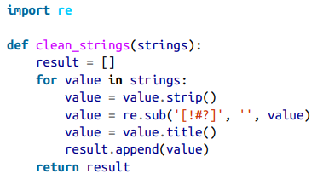
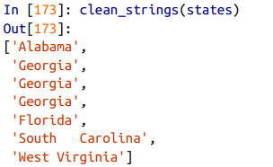
Functions are Objects

Slide 20
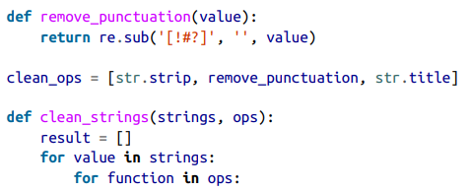
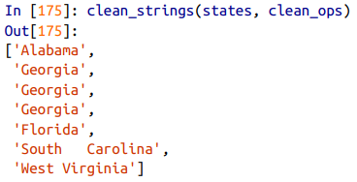

Functions are Objects
An alternative approach that you may find useful is to make a list of the operations you want to apply to a particular set of strings

Slide 21
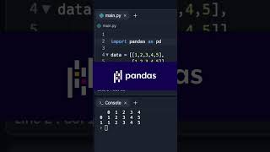
Pandas
SolelyCS. (n.d.). Pandas DataFrame In Python Explained. . . [Video]. YouTube. Retrieved October 6, 2023, from https://youtube.com/shorts/H0JriItTqn8?feature=shared

Slide 22
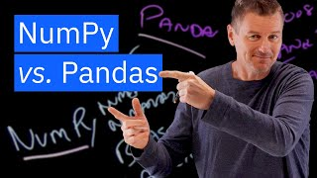
Numpy vs Pandas
IBM Technology. (2023, April 12). NumPy vs Pandas. YouTube. Retrieved October 6, 2023, from https://www.youtube.com/watch?v=KHoEbRH46Zk
‌

Slide 23
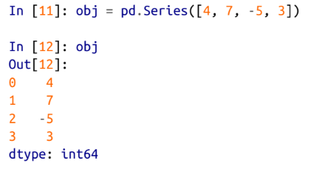
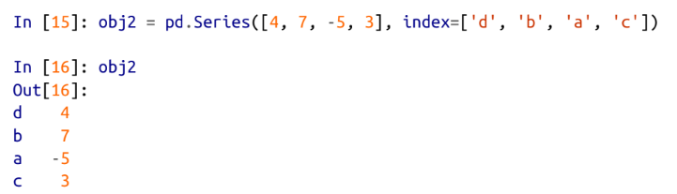
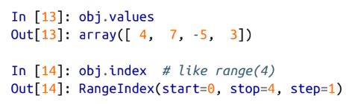
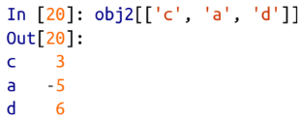
What is a Series
A 1-dimensional array
Default Numpy data type
Each value corresponds to an index

Slide 24
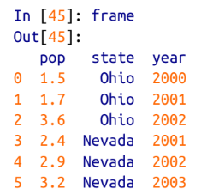
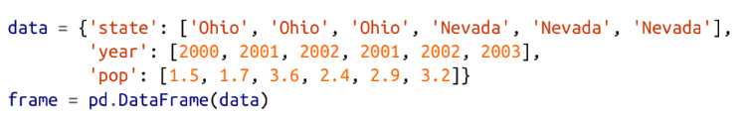
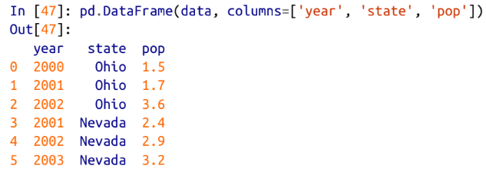
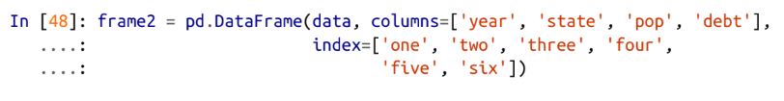

What is a DataFrame?
A rectangular table of data
Contains an ordered collection of columns
Has both a row and column index

Slide 25
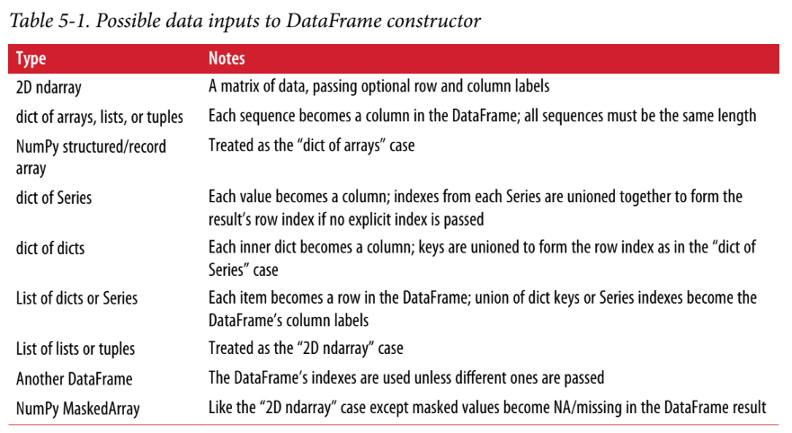

Slide 26
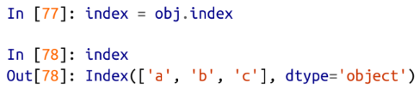
Index Method
Index objects are responsible for holding the axis labels and other metadata
Index objects are immutable

Slide 27
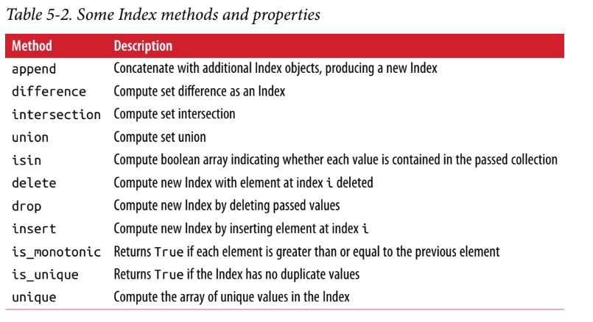

Slide 28
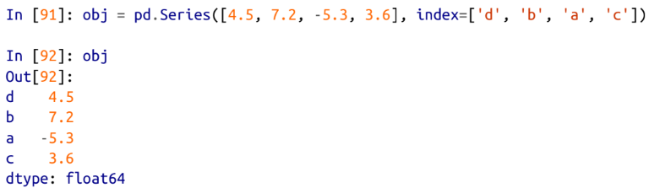
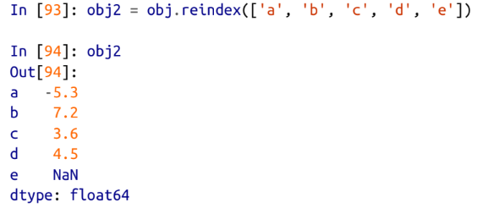
Essential Functionality
Reindexing; create a new object with the data conformed to a new index.

Slide 29
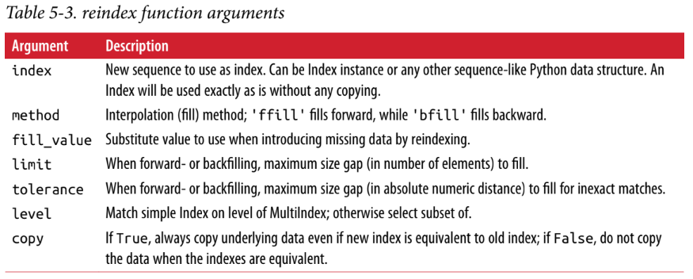
Essential Functionality

Slide 30
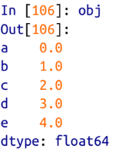
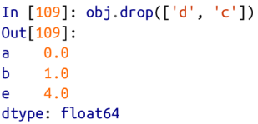
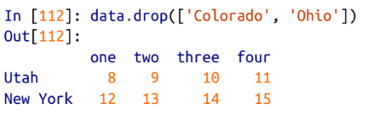
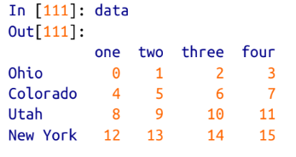
Essential Functionality
Dropping Entries from an Axis; drop method will return a new object with the indicated value or values deleted from an axis

Slide 31
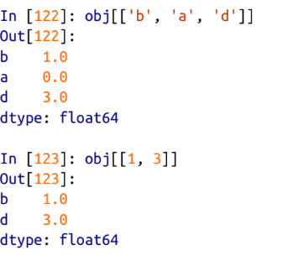
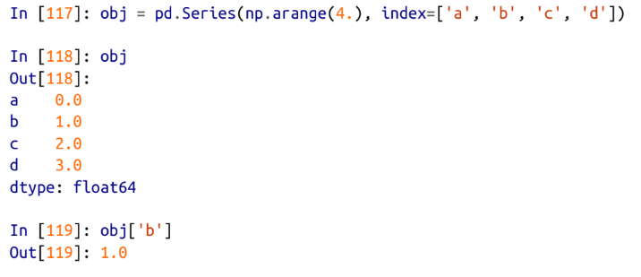
Essential Functionality
Indexing, Selection, and Filtering; Series indexing (obj[...]) works similar to NumPy array indexing, except you can use the Series’s index values instead of only integers.
Slicing works similarly but the end point is inclusive

Slide 32
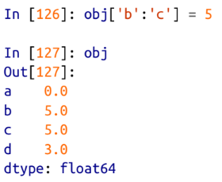
Essential Functionality
Setting using these methods modifies the corresponding section of the Series:

Slide 33
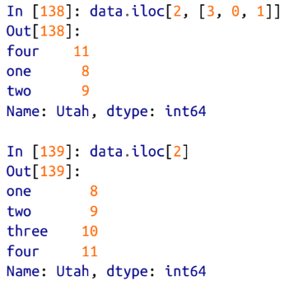
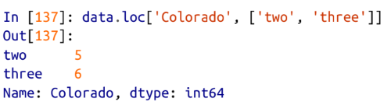
Essential Functionality
loc and iloc; They enable you to select a subset of the rows and columns from a DataFrame using either axis labels (loc) or integers (iloc).
Both indexing functions work with slices in addition to single labels or lists of labels

Slide 34
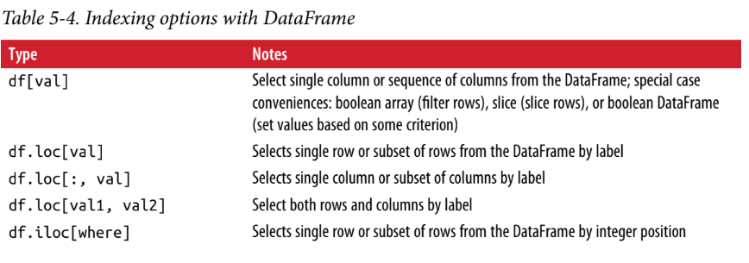
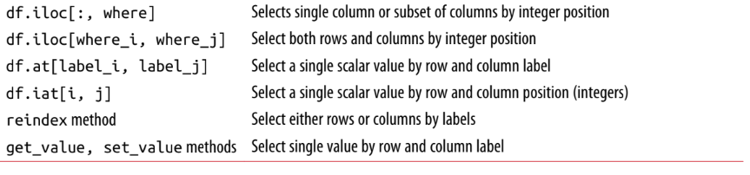
Essential Functionality

Slide 35


Essential Functionality
Working with pandas objects indexed by integers is something that often trips up new users due to some differences
Here we have an index containing 0, 1, 2, but inferring what the user wants (label-based indexing or position-based) is difficult
On the other hand, with a non-integer index, there is no potential for ambiguity:

Slide 36



Essential Functionality
Arithmetic and Data Alignment;When you are adding together objects, if any index pairs are not the same, the respective index in the result will be the union of the index pairs.

Slide 37



Essential Functionality
In arithmetic operations between differently indexed objects, you might want to fill with a special value, like 0, when an axis label is found in one object but not the other

Slide 38

Essential Functionality

Slide 39



Summarizing and Computing Descriptive Statistics
pandas objects are equipped with a set of common mathematical and statistical methods.
Most of these fall into the category of reductions or summary statistics, methods that extract a single value (like the sum or mean) from a Series or a Series of values from the rows or columns of a DataFrame.

Slide 40

Summarizing and Computing Descriptive Statistics

Slide 41




Summarizing and Computing Descriptive Statistics
describe produces multiple summary statistics in one shot

Slide 42


